Slide 1
Warmup (Start new paper for 2.2 Lithosphere and Humans)
What is erosion?
How do we use land? (What do you think?)

Slide 2
Explain needs and consequences for land use
2.2.1a

Slide 3
Urbanization: What is it?
Urbanization, is the physical growth of urban areas as a result of rural migration and even suburban concentration into cities, particularly the very largest ones.

Slide 4
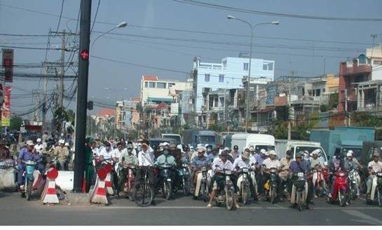

Slide 5
US and World Population Clock
http://www.census.gov/main/www/popclock.html
Why is it needed?
People need places to live. Many move to big cities.
The United Nations projected that half of the world's population would live in urban areas at the end of 2008.
As the human population increases, the need for urbanization also increases.

Slide 6
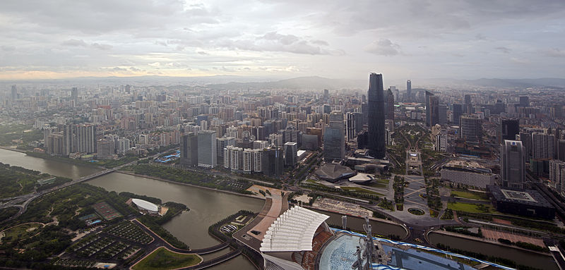

Slide 7
Consequences of Urbanization
Urban sprawl is a multifaceted concept centered around the expansion of low-density development.
In the last 50 years, the greatest percentage of population growth in the US has occurred in two classes: suburban and exurban
With more people moving to the suburbs…you need to remove trees and build houses!
Overpopulation, less land available, etc

Slide 8
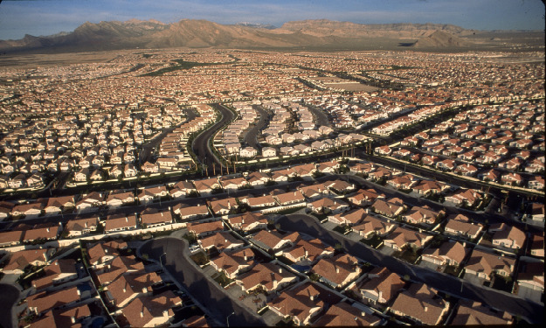

Slide 9
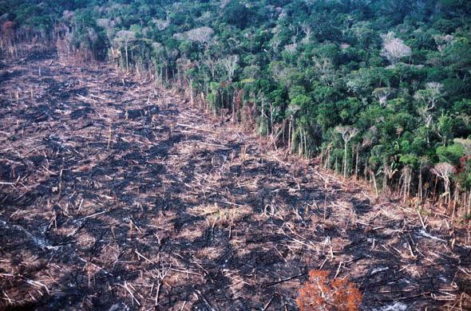
Deforestation
Deforestation is the removal of a forest or stand of trees where the land is thereafter converted to a non-forest use.
Clear Cutting
Selective Cutting

Slide 10
Why is deforestation needed?
Forests provide paper and wood that we use for many common things
We need more land for other uses
Conversion of forestland to farms, ranches, or urban use.

Slide 11
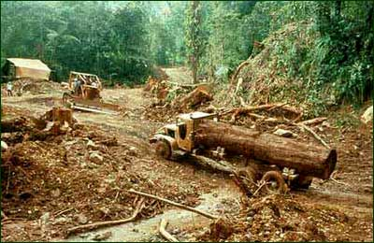
Consequences of Deforestation
Deforestation can cause more erosion/landslides
Roots held soil together, now gone

Slide 12
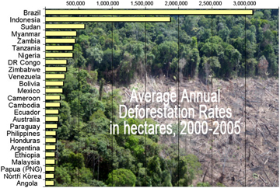
Consequences:
Habitat loss
About half of the world's original forests had been destroyed by 2011, the majority during the previous 50 years. Since 1990 half of the world's rain forests have been destroyed.
More than half of the animal and plant species in the world live in tropical forests.

Slide 13
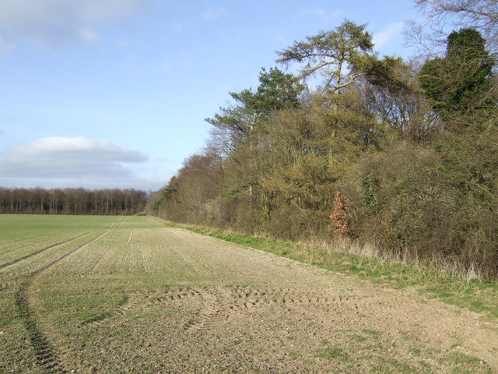
Agriculture
The use of land for growing crops (plants or animals for food and other uses)

Slide 14
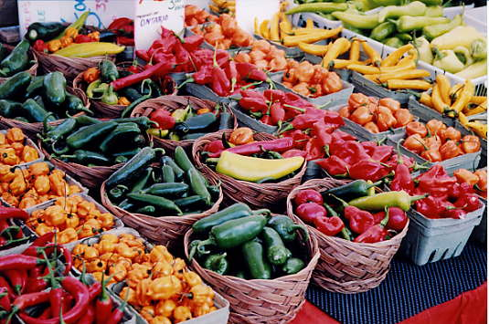
Why is Agricultural Land Needed?
With the world population growing, there is a need to produce more food.

Slide 15
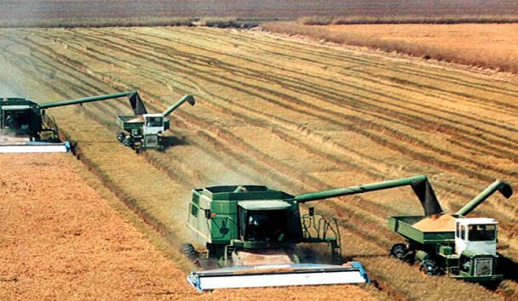
Why is Agricultural Land Needed?
Therefore, we maximize the land use for farming.
Due to this urban sprawl, houses are taking the place where agricultural lands have been.
Commercial agriculture is large-scale production of crops for sale, intended for widespread distribution to wholesalers or retail outlets

Slide 16
Consequences of Agriculture
Traditional (small-scale) agricultural practices are being replaced by massive farming operations using chemical fertilizers, pesticides, etc.
Again, there is a need for the removal of forest land to produce agriculture land.
However, this might take away from the land needed for housing…
What do you do?

Slide 17
Overall:
There is a global need to use land for human use.
More people need more homes and like the suburban feel.
As a result, there is an increase in deforestation and more of a need for agriculture land.

Slide 18
400 Acre Wood
Read front of worksheet for background info
Decide on how to divide your land between the different uses
Calculate the consequences (# visitors, animals, trees, transport, money, etc)
Honors: Draw scale map of your park
Include color
Use key/labels
Record # owls, woodrats, salamanders, trees, and net profit/loss on key

