Slide 1
Warmup
Why might we need to deforest land?
What is a consequence of agriculture?

Slide 2
2.2.1 Explain ways to mitigate detrimental human impacts on the lithosphere and maximize sustainable use of natural resources

Slide 3
Overgrazing
Problem
Destruction of vegetation caused by too many grazing animals consuming the plants in a particular area
Compacts the soil
Plants cannot recover (grow back)
Solution
Rotate animals on plots of land/fields
Don’t put too many animals on a single field

Slide 4
Erosion
Problem
Soil can lose its fertility (minerals, decaying matter runs off
Soil runoff ends up in our water systems

Slide 5
Runoff from Farms
Sewage and farm erosion cause nutrients to enter the lake
Over-nourishment of the lake causes algae to bloom (grow a lot)
Algae use up oxygen, fish die
Dead things are decomposed by bacteria which produce smelly gasses

Slide 6
Prevent Erosion/Runoff
Contour plowing
Terracing
Reduces runoff by trapping soil/water in each step
So runoff does not continue down the whole mountain
Groundcover
Plants trap soil in their roots to prevent runoff/erosion
Building and Protecting soil
Topsoil soil takes a very long time to be made
We need to protect or make more of it through compost so plants can grow
Retention ponds trap runoff in one area
Sediment fences buffer construction sites

Slide 7
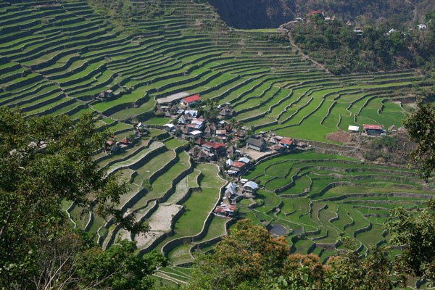

Slide 8
Case Study: Slippery Slope
With a partner (sitting next to you) read the case study and answer the questions (10 total) on a separate piece of paper.

Slide 9
Soil Runoff Challenge
Activity: Peace Corps: Soil Runoff Challenge

