Slide 1
Warmup
What do you think is the best way to prevent erosion?
Why?

Slide 2
2.2.1c Shorelines
Explain the effects of human activity on shorelines, especially in development and artificial stabilization efforts.

Slide 3
Waves
Waves are continuously beating against the shoreline.
This continuous motion will cause the shoreline to change shape over time.
The sawing and grinding action of rock fragments in the water is called abrasion.
Abrasion creates all sorts of geological structures along the shoreline.

Slide 4
Waves
Shoreline abrasion has the power to smooth rocks.

Slide 5
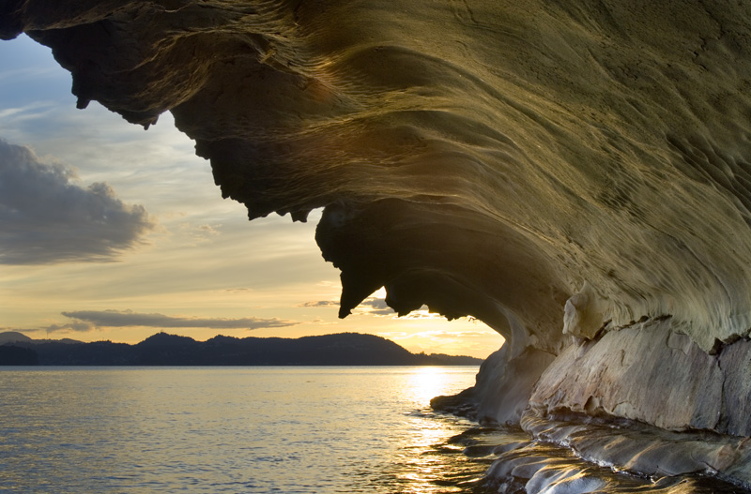
Waves
Shoreline abrasion has created this sandstone cliff off the coast of British Columbia.

Slide 6
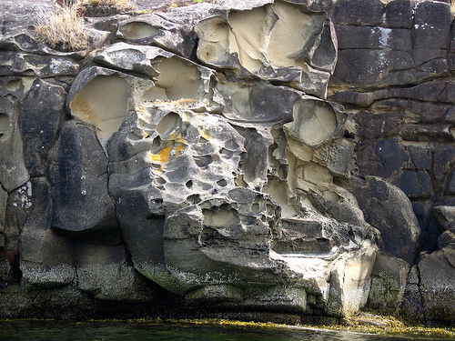
Waves
Shoreline abrasion has created this sandstone cliff off the coast of British Columbia.

Slide 7
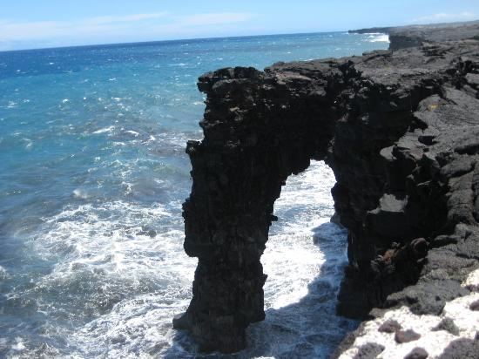
A Sea Arch formed by abrasion and erosion.

Slide 8
Waves
In some areas, like the Outer Banks of North Carolina, work is being done to protect the shoreline and keep it from being eroded.
Three protective structures that protect a shoreline from erosion are: beach nourishment, jetties, and seawalls.

Slide 9
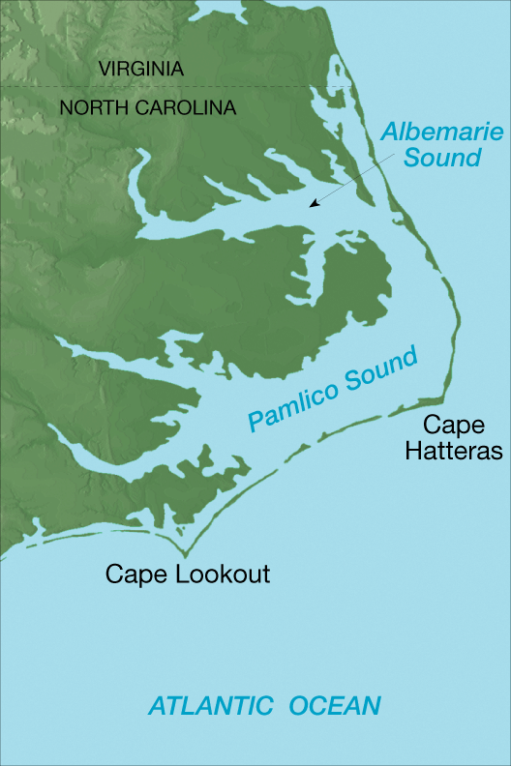
Why would it be important to protect shorelines like the Outer Banks?

Slide 10
Waves
Beach nourishment is the addition of large quantities of sand to the beach system.
Beach nourishment decreases beach erosion without the construction of protective structures.

Slide 11
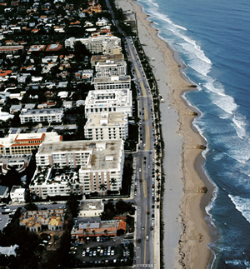
Why would beach nourishment be important in an area like this?

Slide 12
Waves
A jetty is a structure, typically made of stone or cement, built perpendicular to the shore and extends into the water.
It prevents longshore drift by holding sand in place and preventing it from washing away.
Video: Long shore drift

Slide 13
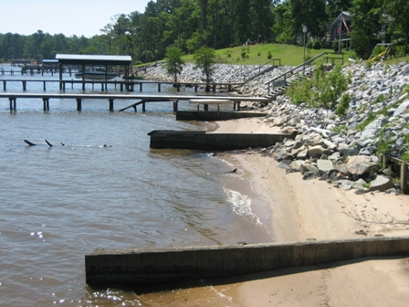
Waves
Groins are like small jetties that are built to trap sand to keep the shoreline from losing sand.

Slide 14
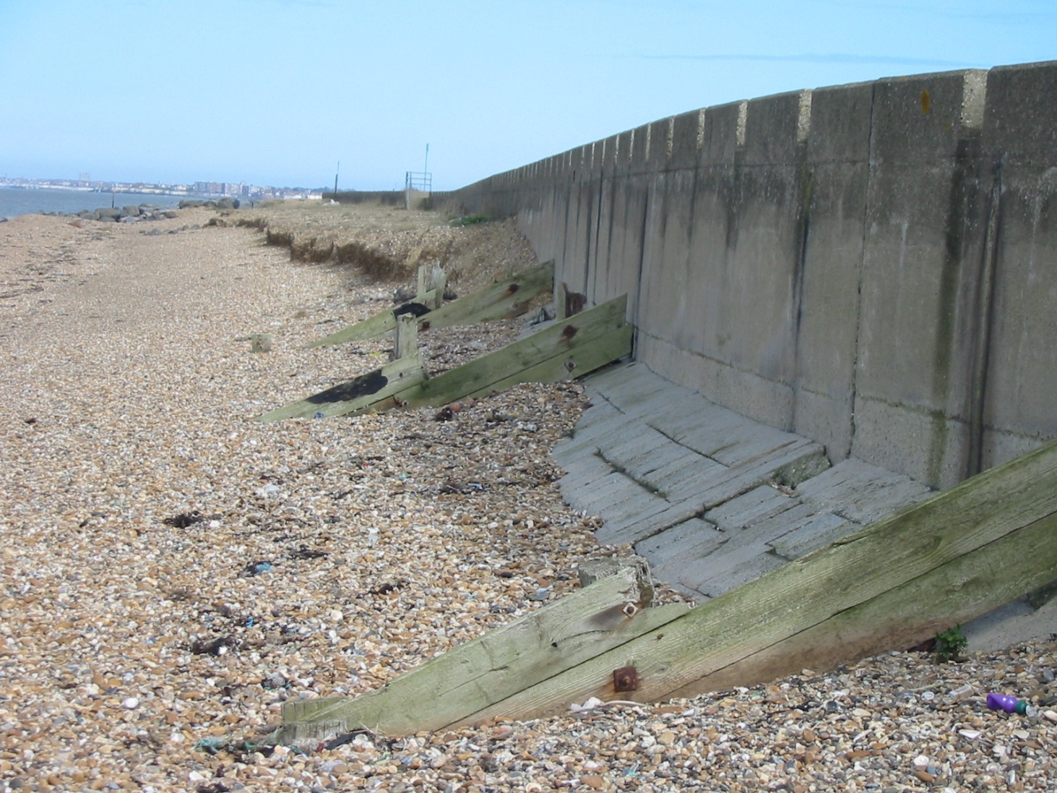
Waves
A Seawall is a wall built to shield the coast and defend property from breaking waves.

Slide 15
Human Activities on Mountainsides
2.2.1.d

Slide 16
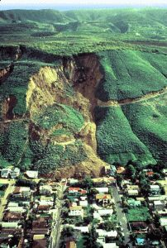
Notes:
Slump

Slide 17
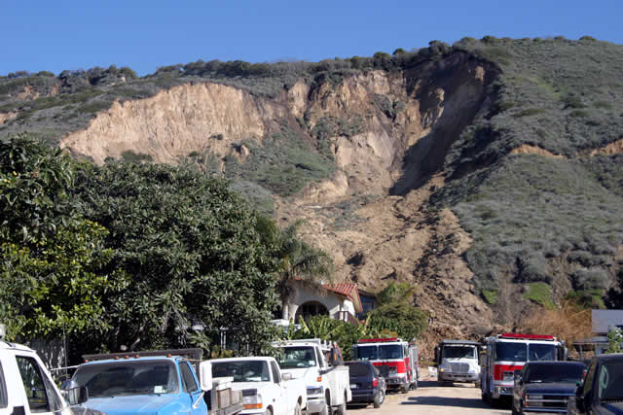
Notes:
Landslide!

Slide 18
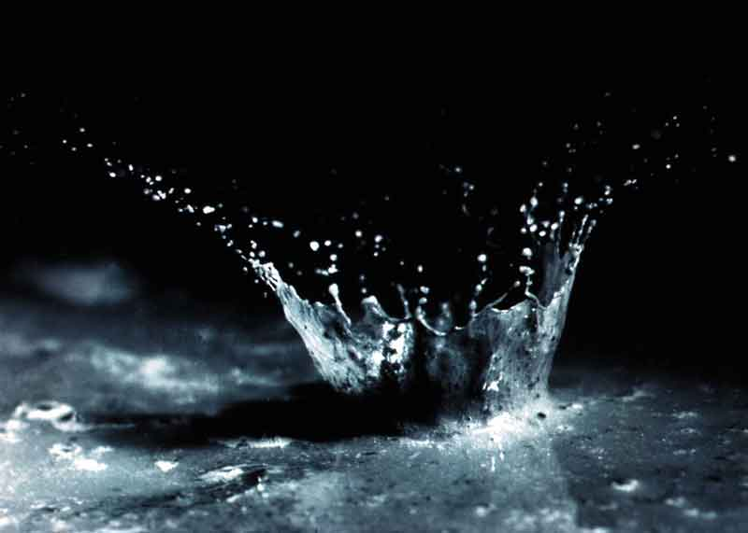
Erosion via Running Water
With few exceptions, water has more power to move large particles of weathered material than wind does.
Stream erosion is greatest when a large volume of water is moving rapidly.
Swiftly flowing water can carry material over a greater distance.
Small streams at high elevations flow down to join larger streams at lower elevations draining an area called a watershed. (WATER FLOWS DOWN)

Slide 19
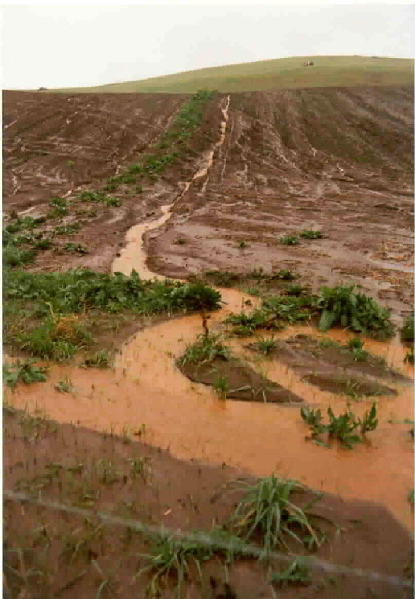
Variables that can cause this…
Water
On a slope, too little water may prevent sediment grains from holding together at all, thereby increasing the material’s potential for movement.
The addition of water to sediments on a slope helps holds the grains together and makes the material more stable.
Too much water can make a slope unstable.
Water is very important to the process of mass movement.

Slide 20
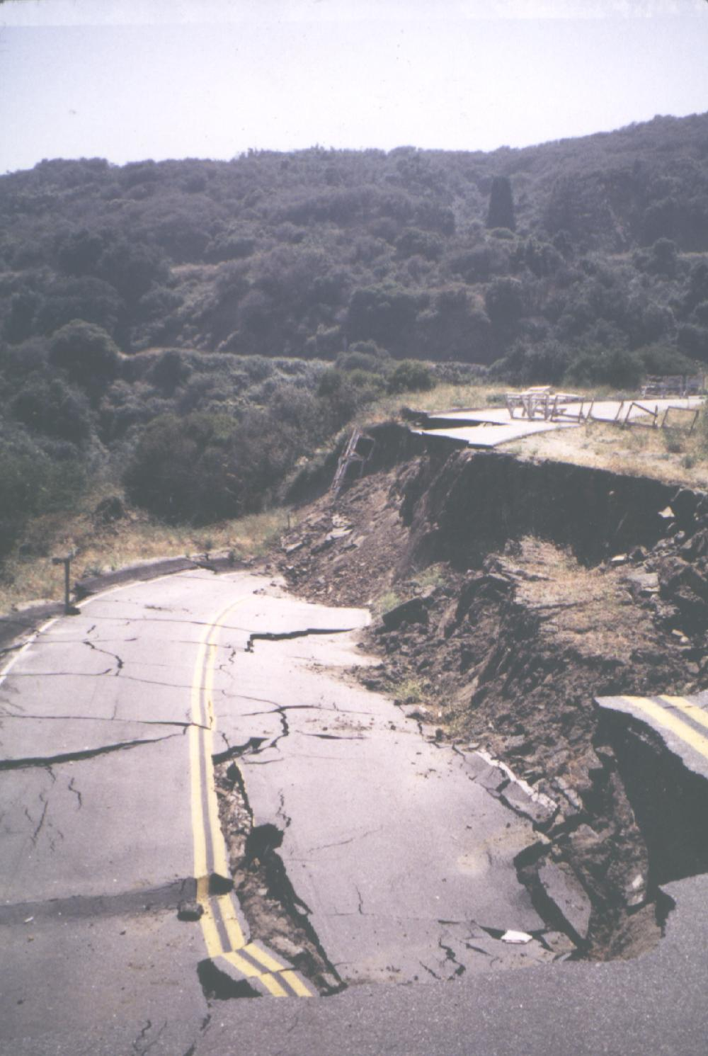
Water is Important!
Adds weight, which leads to instability.
It also lubricates loose material, and starts it moving.
So what can be done?

Slide 21
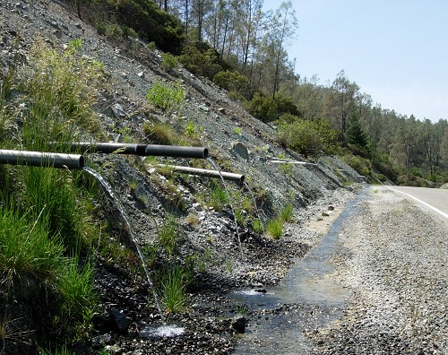
Drainage for hillsides!
Or…

Slide 22
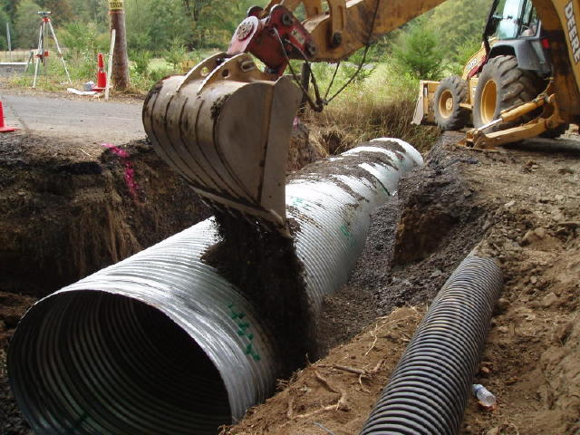
Culverts!

Slide 23
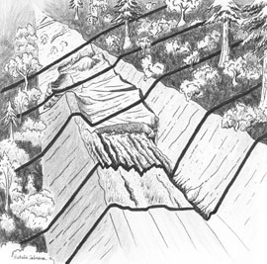
How Humans play a part in all this…
Human activities often contribute to the factors that cause mass movements.
Activities such as constructing heavy buildings, roads, and other structures can make slope materials unstable.
Cut and Fill

