Slide 1
Warmup
What are three methods to stabilize shorelines?
What are three methods to stabilize mountains?

Slide 2
Warmup
What are three land uses?
Which is the most important?

Slide 3
Traditional Energy Sources
2.2.2 Compare the methods of obtaining energy resources: harvesting (peat and wood), mining (coal and uranium/plutonium), drilling (oil and natural gas) and the effect of these activities on the environment.

Slide 4
Fossil Fuels (Write at top of notes)
Fossil fuels are hydrocarbons that may be used as fuel, including coal, oil, and natural gas.

Slide 5
Harvesting
Collecting nonrenewable or renewable resources
What is a renewable resource?
What is a nonrenewable resource?

Slide 6
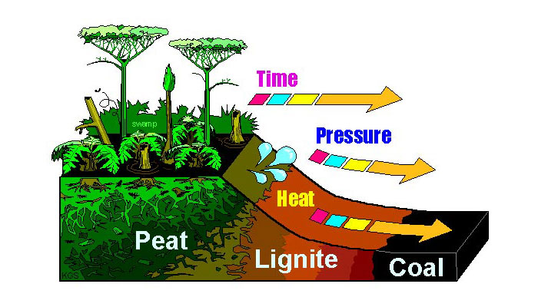
Peat
Peat is partially carbonized organic matter.
A nonrenewable resource
Energy: Dry peat is burned as fuel and also used in agriculture
Notes:
Source: � Steve Greb, Kentucky Geological Survey

Slide 7
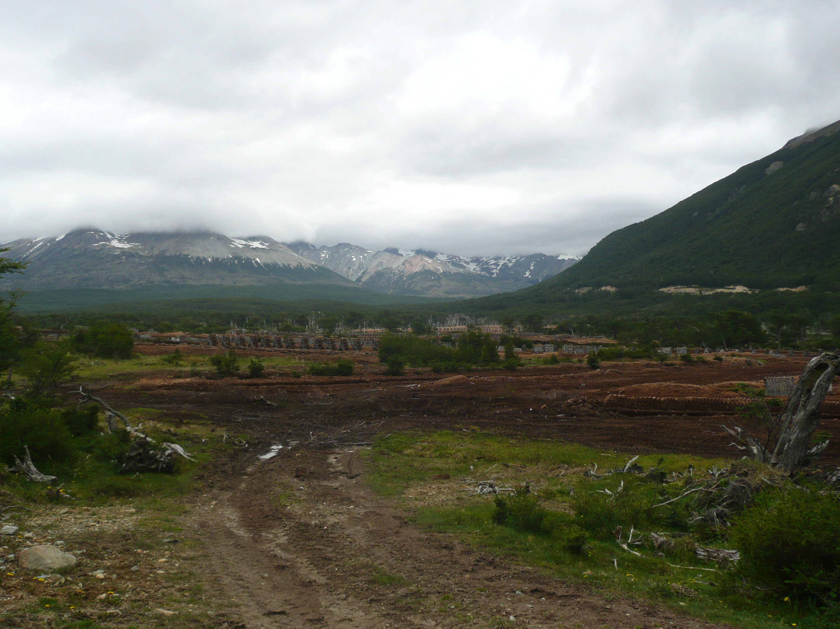
Environmental Impact:
Habitat destruction, when you remove topsoil and the peat below it, you remove the possibility of the habitat recovering

Slide 8
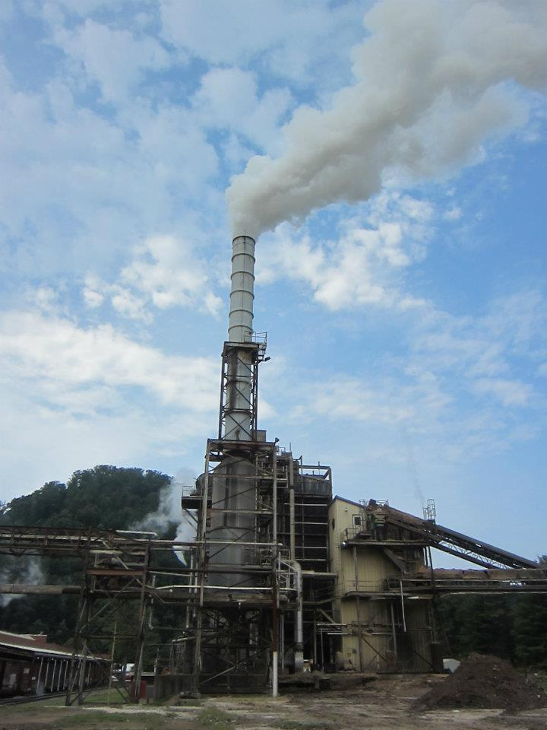
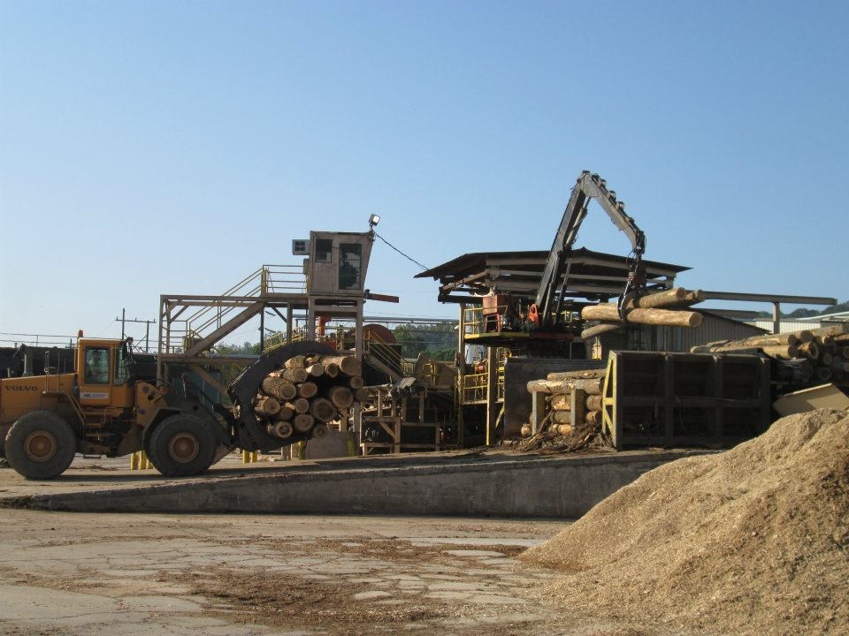
Wood
Wood is hard, cellulose matter of a tree
It is a renewable resource
Lumber and Paper Mills

Slide 9
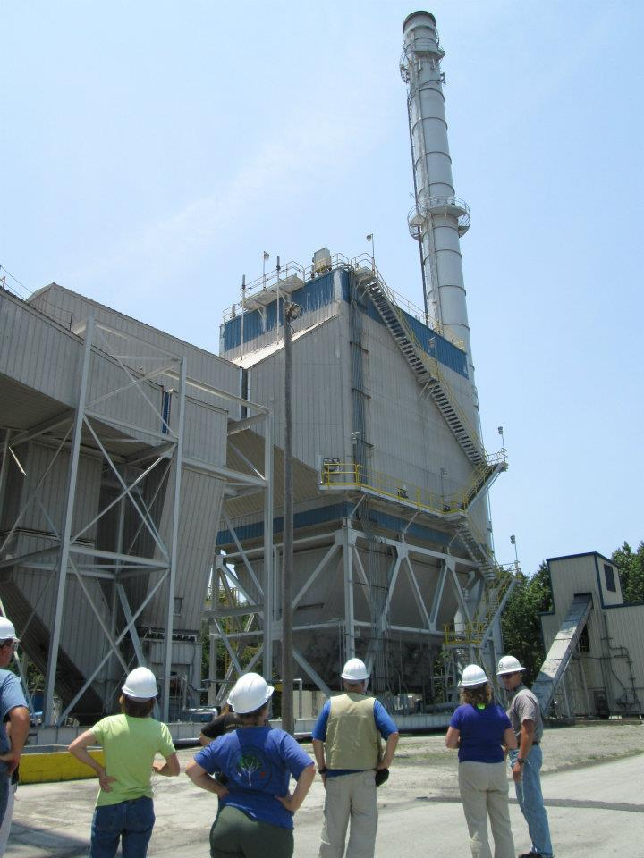
Wood
Energy: wood is burned directly for energy
Craven County Wood Energy
Wood heats water -> creates steam -> turns turbine -> generates energy
OR combustion

Slide 10
Wood
Environmental Impact:
Harvesting wood can be done sustainably...
If not, it can lead to deforestation and habitat loss

Slide 11
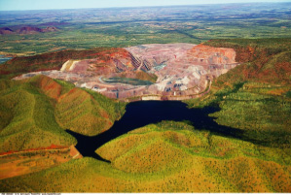
Mining
Digging to obtain many mineral resources
Surface/Open pit mines dig on the top while underground mines dig in tunnels

Slide 12
Coal
Coal is a solid fossil fuel
It is one of the least expensive sources of power
Energy: Burn it (to create steam or through combustion)
Notes:
http://www.energyville.com/sourcesanddemands/coal/

Slide 13
Coal and the Environment
Contributes to global warming
37% of US carbon emissions; second only to China
Burning of coal is a source of other pollutants including sulfur dioxide that reacts with oxygen and water to produce acid rain
Harms forests, bodies of water, and wildlife
Emissions from developing countries is expected to grow.
China’s coal consumption has grown by 300% over the past 30 years while the rest of the world has used 75% more coal
Most new coal plants are not using carbon capture technology

Slide 14
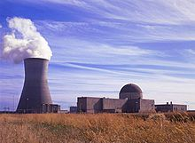
Nuclear Energy (Uranium)
The fuel for the nuclear fission in nuclear reactors is uranium or plutonium
Energy:
The uranium nuclei split into smaller nuclei and emit neurons and high energy
Energy heats water -> creates steam -> drives a turbine = generates energy
Shearon Harris Nuclear Power Plant, New Hill, NC

Slide 15
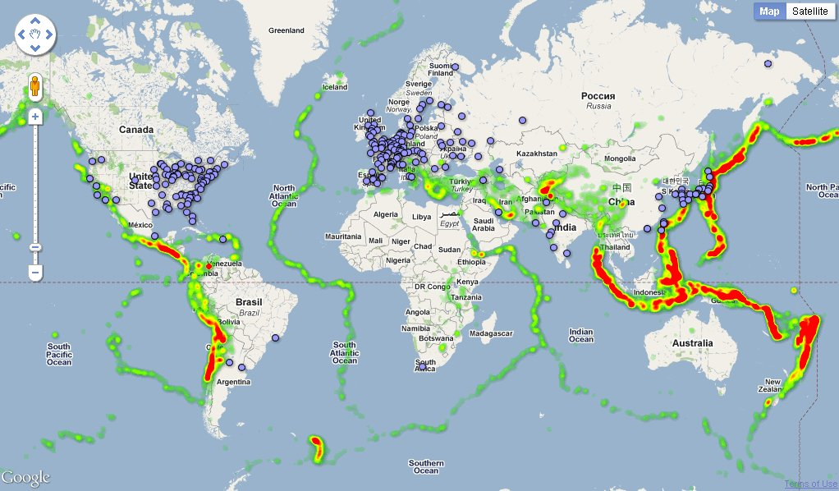
Nuclear Impacts
High fossil fuel prices = interest in nuclear power
Expensive start-up costs
Takes 5 years to build reactor at $4-5 billion
441 commercial reactors operating in 29 countries that provide 14% of the planet’s electricity.

Slide 16
Nuclear Power and the Environment
Nuclear power is viewed as risky
Major accidents are rare, but when they do occur they can have serious, adverse effects on the health and safety of communities.
Create dangerous radioactive waste and are potential terrorist targets

Slide 17
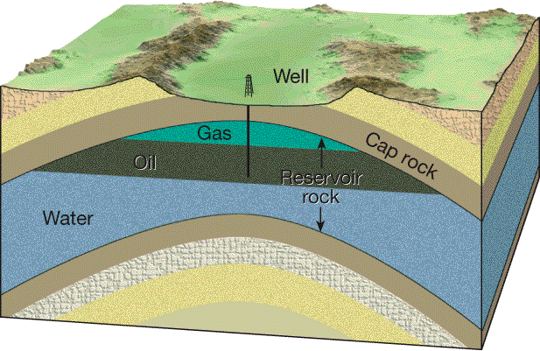
Drilling
How do we know what’s down there?
Video: How Chevron Uses Seismic Technology

Slide 18
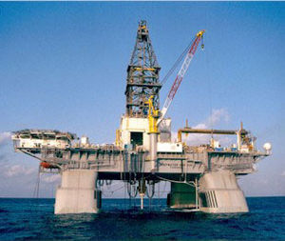
Oil
Technology is improving recovery rates of oil and leading to the discovery of oil in new places.
Drillers head for deeper water

Slide 19
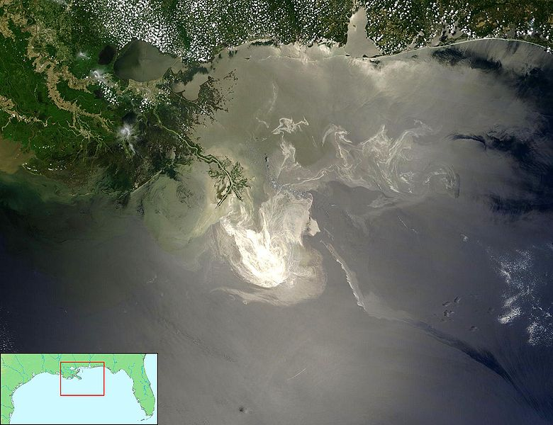
Oil and the Environment
High environmental impact
Spills highlight potential risks of offshore drilling
Deepwater Horizon drilling rig in the Gulf of Mexico spilled 4.4 million barrels of crude oil
Severely damaged local marine and wildlife habitats

Slide 20
Fuels derived from tar sand and oil shale could become substitutes for dwindling petroleum supplies.
But…
Need to heat rock to produce petroleum
Serious ecological and land use implications including regional air quality problems and greenhouse gas emissions

Slide 21
Natural Gas
Preferred option for new power stations
Lower capital costs and shorter construction times
Most efficient to burn (more energy generate through combustion)
Abundant energy source
Lots of massive gas in shale rock in US
Currently Russia (25%), Iran (16%) and Qatar (14%) dominate the natural gas industry

Slide 22
Natural Gas: Hydraulic Fracking
Video: How Hydraulic Fracking works
http://www.youtube.com/watch?v=timfvNgr_Q4

Slide 23
Natural Gas and the Environment
Natural gas is cleaner
Lower carbon content and smaller contribution to local air pollution
Large amounts of water are required
Water waste must be dealt with
Video: Natural gas in your water?

Slide 24
Clear off your desks
Read the directions

