Slide 1
Coach Barton
Earth/environmental science

Slide 2
ALUMNI

Slide 3
UNC Charlotte – Go Niners

Slide 4
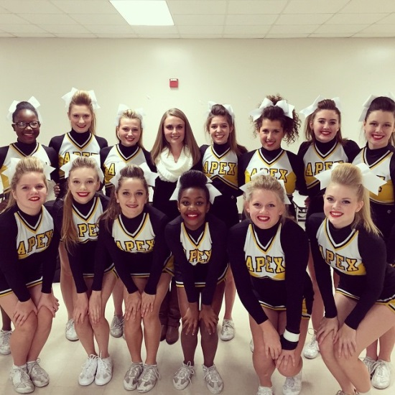
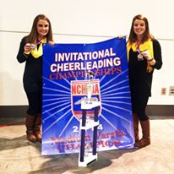
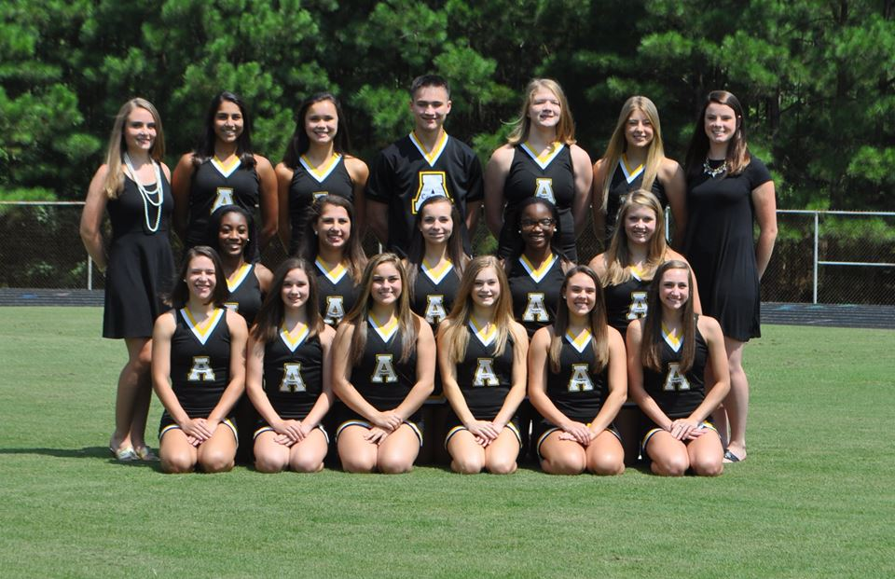
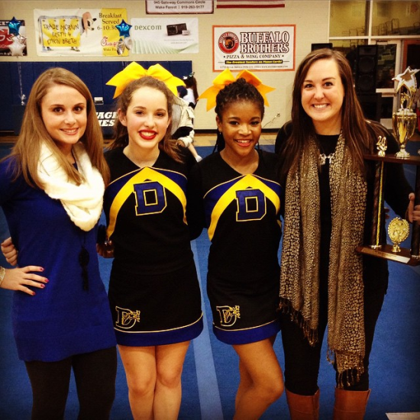
Cheer and Stunt

Slide 5
Earth/Environmental
Earth/Environmental Science focuses on inquiry into the functions of the earth's systems and man’s interaction with the environment.

Slide 6
The curriculum is organized into units based on the spheres of the Earth:
Lithosphere
hydrosphere,
Atmosphere
Biosphere
with a final unit on Astronomy
Each unit focuses on the processes that drive the system as well as how it affects humans and how humans can affect it.

Slide 7
Essential Standards
Students will learn:
1.1 Explain the Earth’s role as a body in space.
2.1 Explain how processes and forces affect the lithosphere.
2.2 Understand how human influences impact the lithosphere.
2.3 Explain the structure and processes within the hydrosphere.
2.4 Evaluate how humans use water.

Slide 8
2.5 Understand the structure and processes within our atmosphere.
2.6 Analyze patterns of global climate change over time.
2.7 Explain how the lithosphere, hydrosphere, and atmosphere individually and collectively affect the biosphere.
2.8 Evaluate human behaviors in terms of how likely they are to ensure the ability to live sustainably on Earth.

Slide 9
Grading
Tests/Projects 40%
Quizzes 15%
Intermediate Assessments 45%
Class work, labs, warm-ups, mini-projects, articles, etc.
Assignments are assigned point 5-30 points
**Test corrections can be completed at tutoring on Thursdays from 2:20-3:30.

Slide 10
Final Course Grade
First 9 weeks 40%
Second 9 weeks 40%
Common Assessment (Final Exam-entire curriculum) 20%

Slide 11
Success
Please make sure that your child is:
Turning in his/her assignments on time
Getting make-up work when absent
Completing homework
Studying vocabulary daily
Keeping up with his/her notebook

Slide 12
Contact
Ms. Barton
sbarton@wcpss.net
www.bartonscience.weebly.com
Mrs. Long
mlong@wcpss.net

Slide 13
Index Card
Please write your child’s first and last name on the card.
Let us know how we can assist your child in being successful in our class.

